Slide 1
DEPLOYING WORDPRESS WEB APPLICATION USING DOCKER IN AMAZON WEB SERVICES

Slide 2
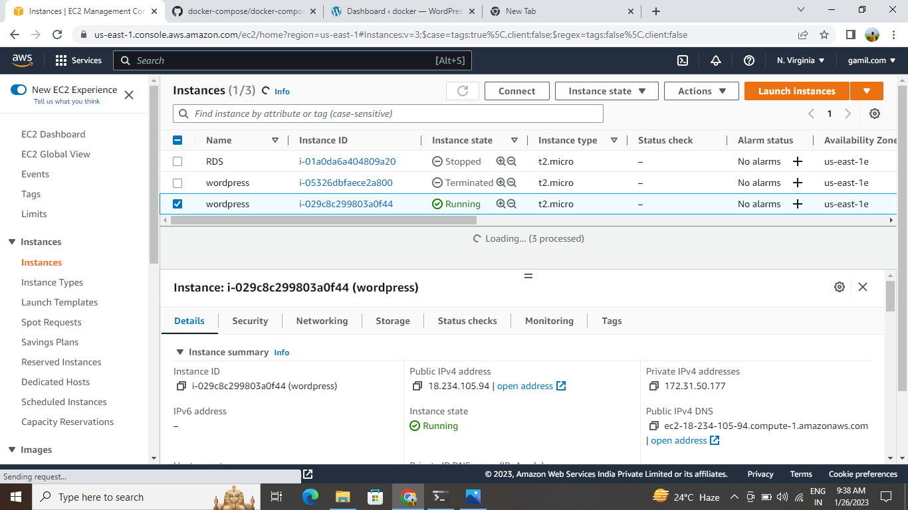
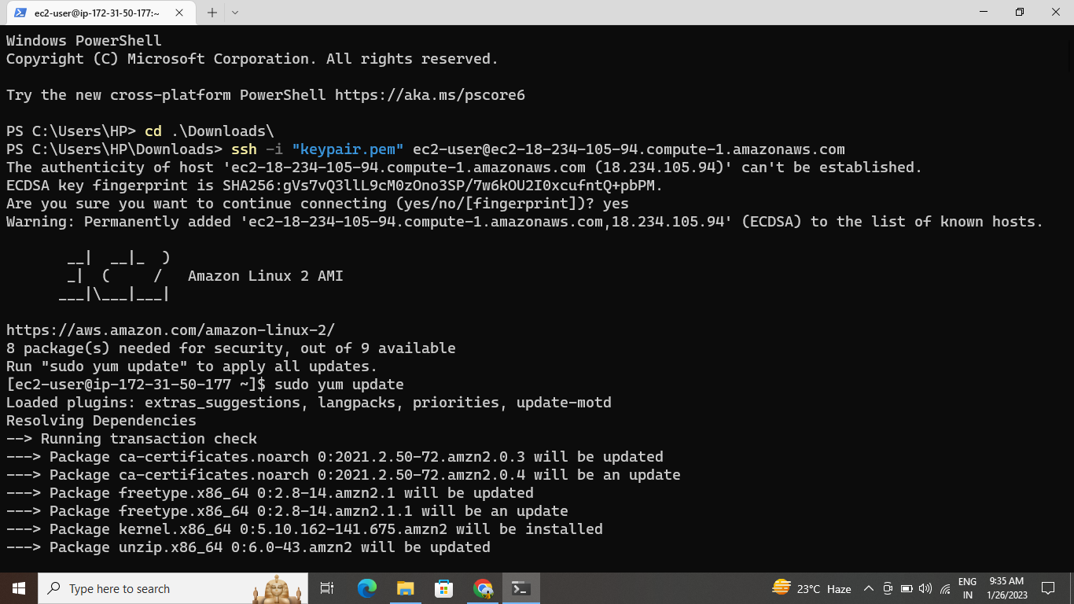
Create an EC2 instance with a Linux machine.
The security group for
Inbound rules as SSH-22, HTTP-80, HTTPS-443
Outbound rules as ALL TRAFFIC
connect the instance to the terminal.

Slide 3
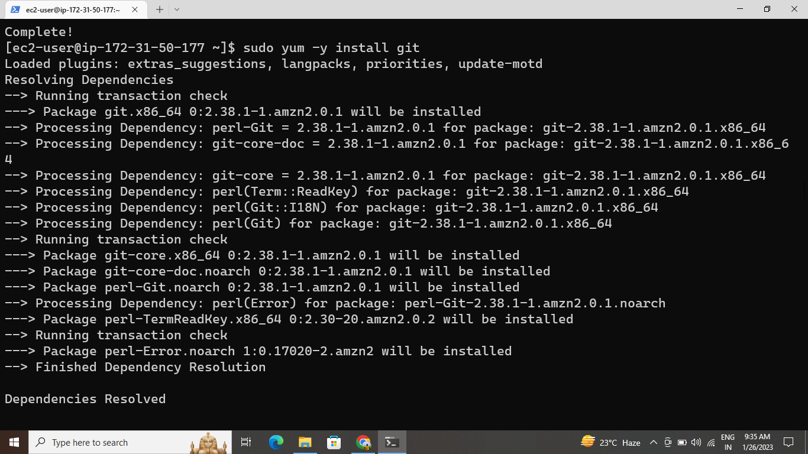
INSTALLING GIT,
Sudo yum –y install git command used to install git in local repository
Git is a DevOps tool used for source code management. It is a free and open-source version control system used to handle small to very large projects efficiently. Git is used to tracking changes in the source code, enabling multiple developers to work together on non-linear development

Slide 4
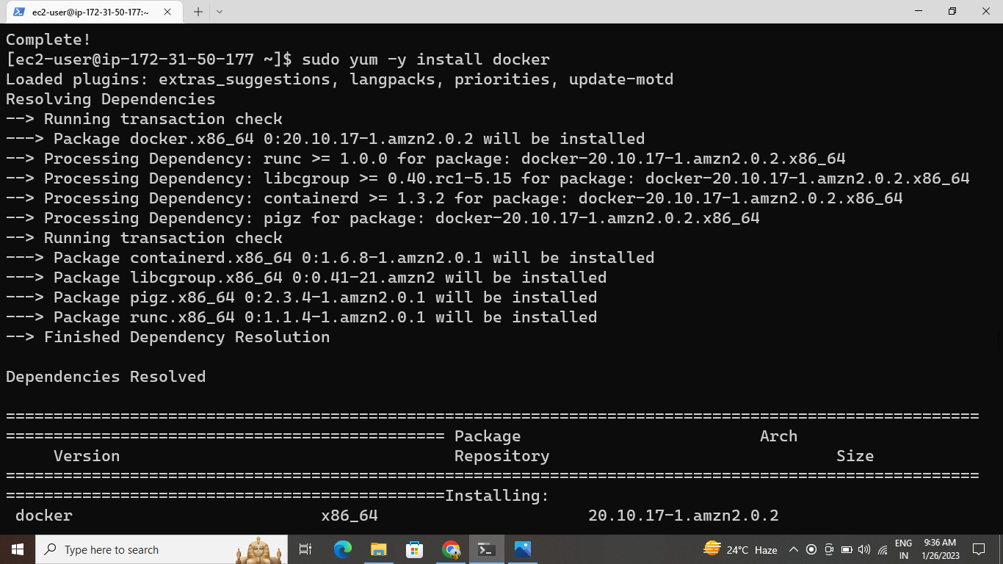
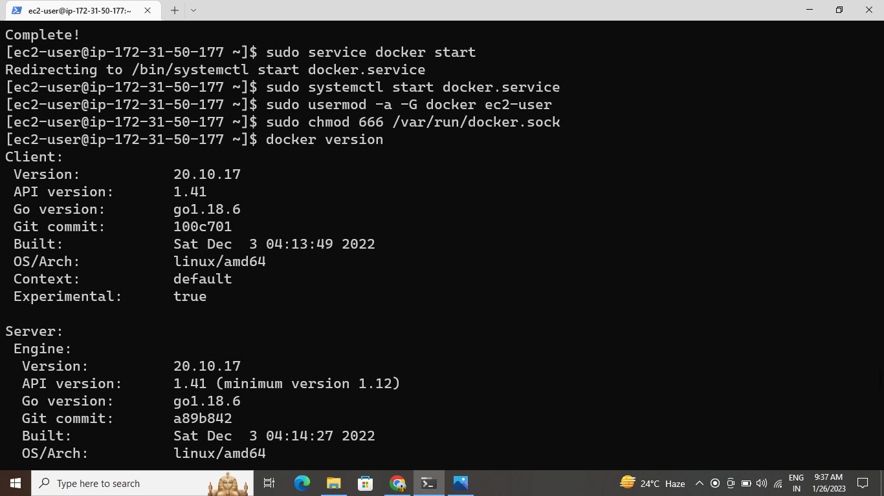
Install Docker and Docker compose in local repository
Sudo yum –y install docker
Sudo systemct
Sudo usermod –a –G docker ec2-user
Sudo service docker start
sudo docker.service
Sudo chkconfig docker on
Docker is an open platform for developing, shipping, and running applications. Docker enables you to separate your applications from your infrastructure so you can deliver software quickly. With Docker, you can manage your infrastructure in the same ways you manage your applications.

Slide 5
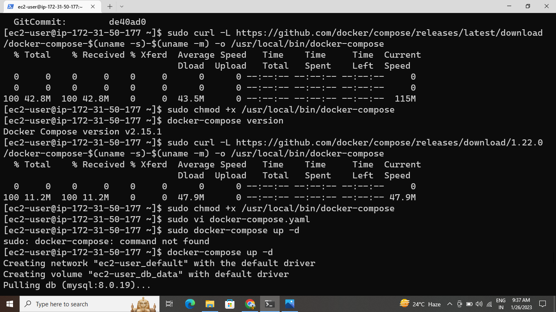
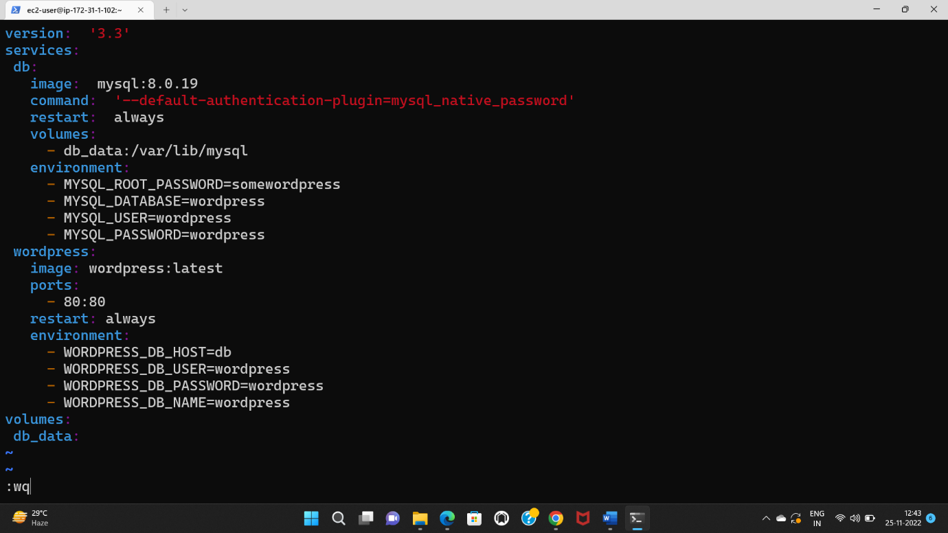
Docker-compose
Download docker-compose latest version from the browser by clicking “install docker-compose on amazon linux -2 ”.
Sudo chomd =x /usr/local/bin/docker-compose
Sudo ln –s /usr/local/bin/docker-compose /usr/bin/docker-compose
Sudo docker-compose –version
Sudo vi docker-compose.yaml
Edit script
Deploye the code
Sudo docker-compose up –d to deploye the code and run the application

Slide 6

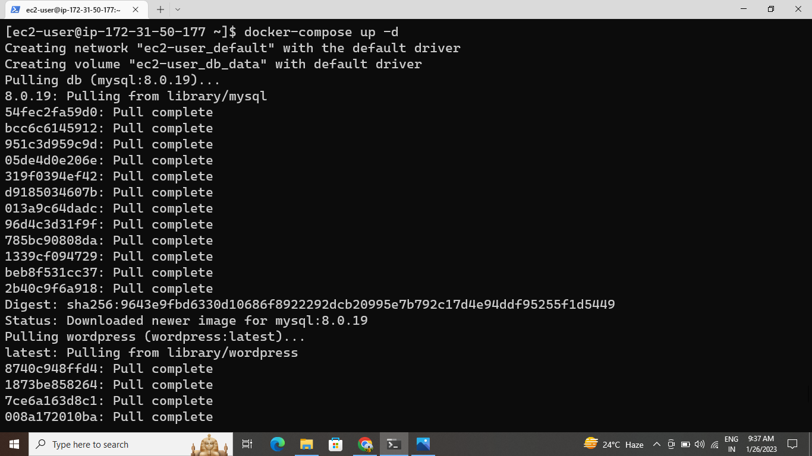
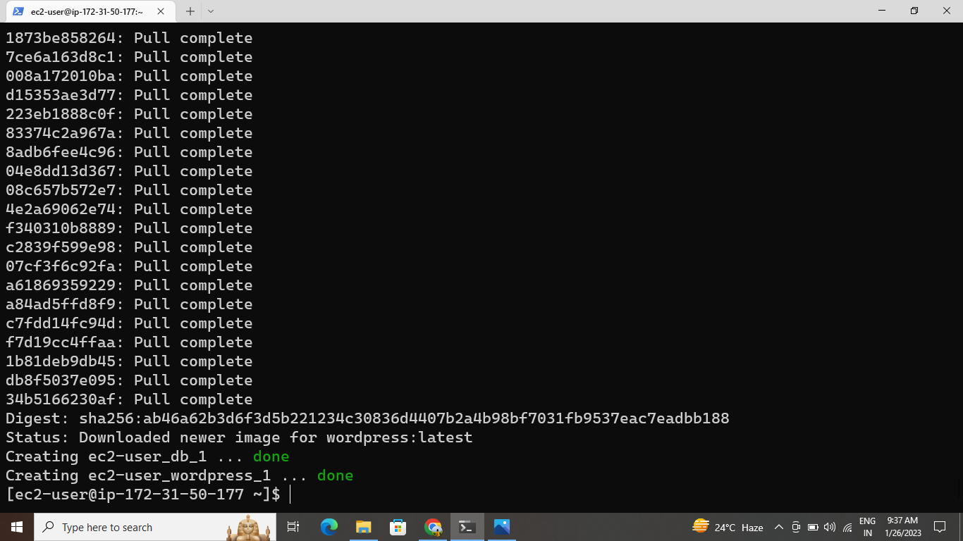
CREATING WORDPRESS SETUP FOR DOCKER IMAGES WITH THE HELP OF YAML SCRIPTING

Slide 7
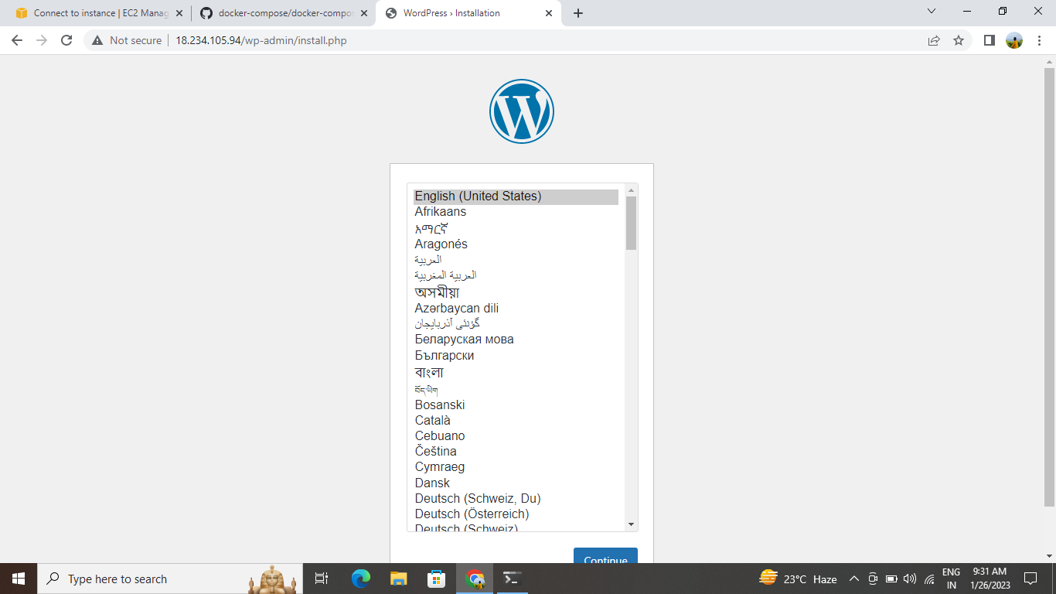
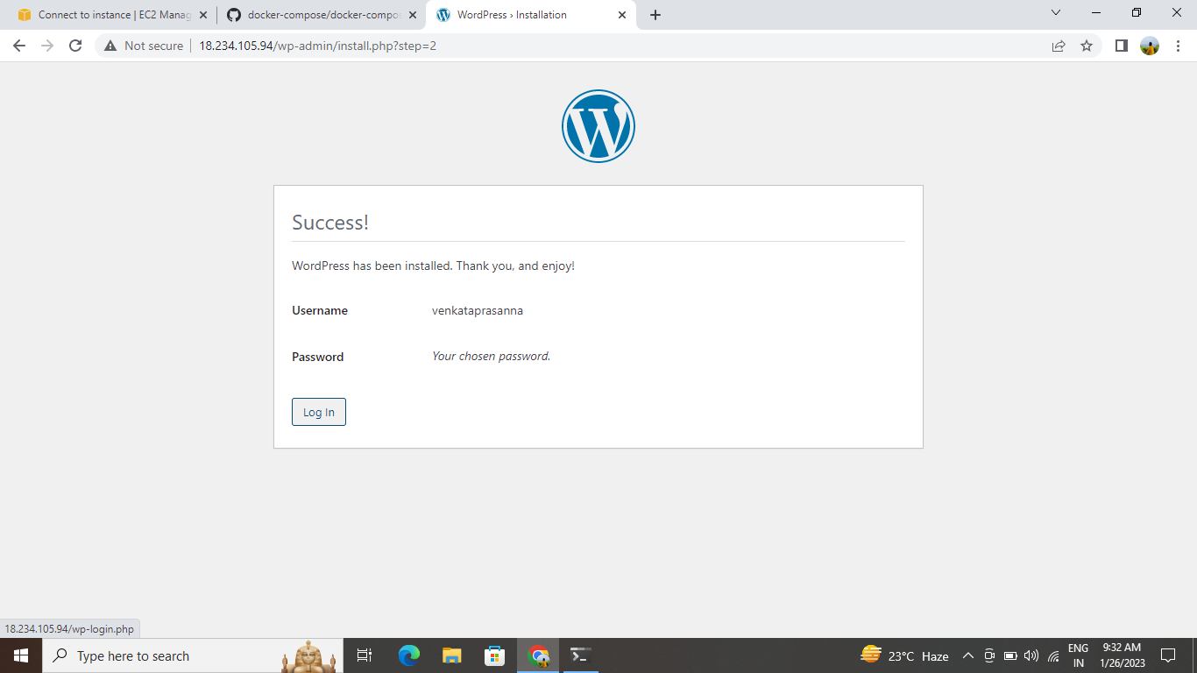
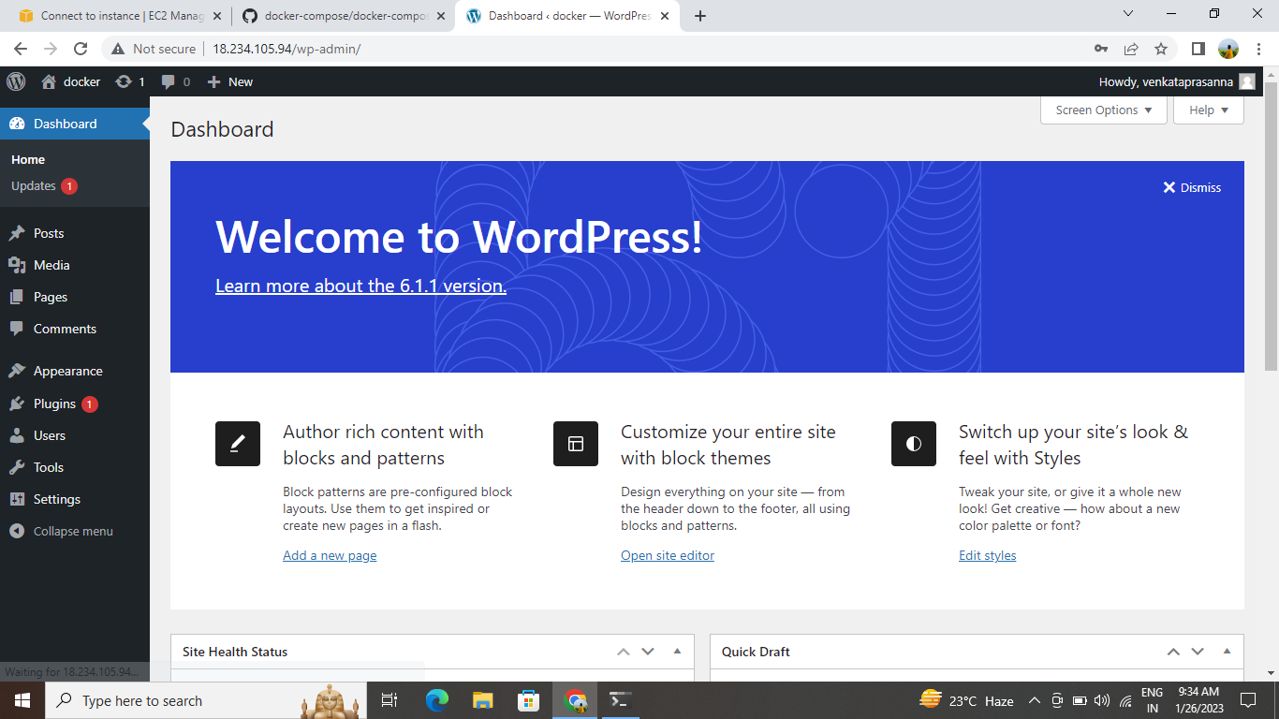
Word press
Copy the public ip address and search in web browser add port no 8080 to start and open the word press

Slide 8
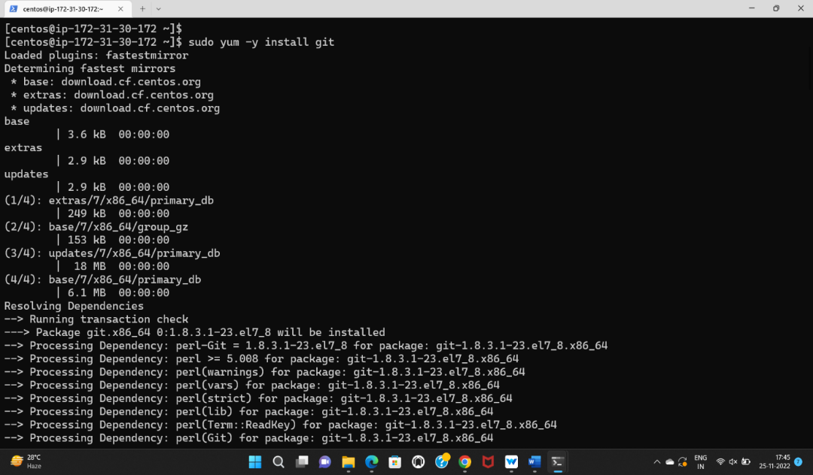
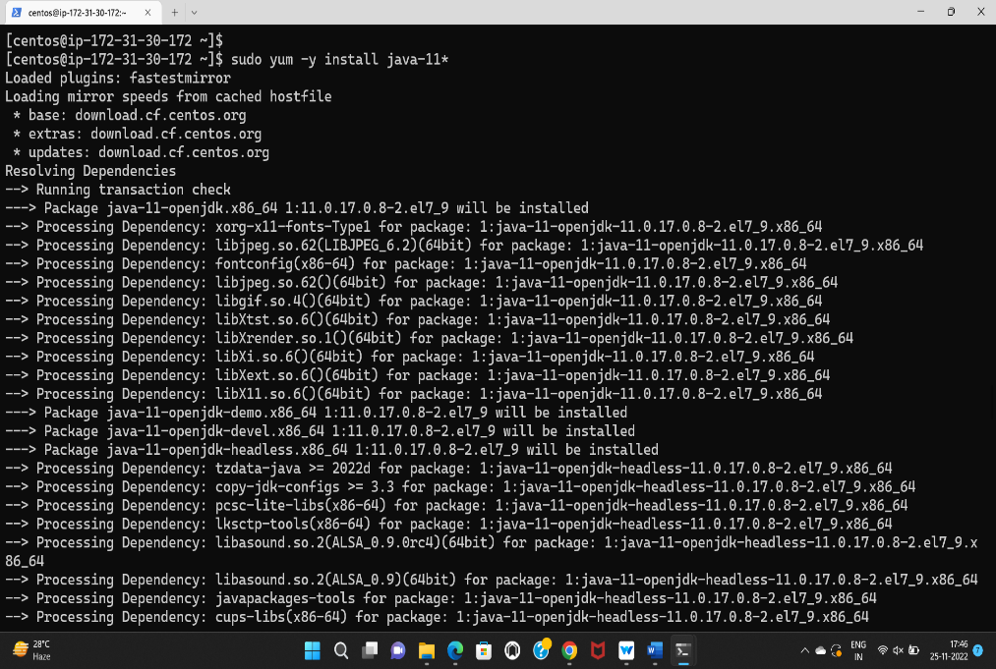
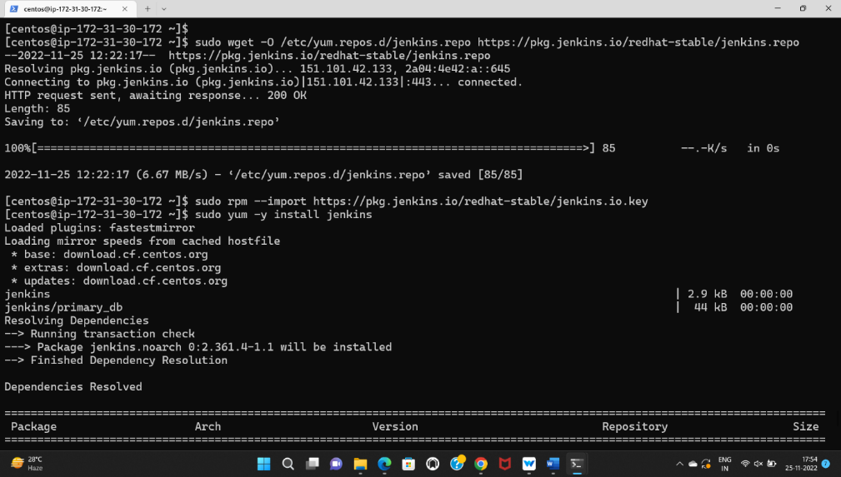
Create a repo in the github account, and clone that code .
Now move the file local repository to remote repository.
Now add the file by using command “git add --repos”
Now commit the file by using “git commit -m “all” repos
Install git, docker, java,
and jenkins
Jenkins is an open source continuous integration/continuous delivery and deployment (CI/CD) automation software DevOps tool written in the Java programming language. It is used to implement CI/CD workflows, called pipelines

Slide 9
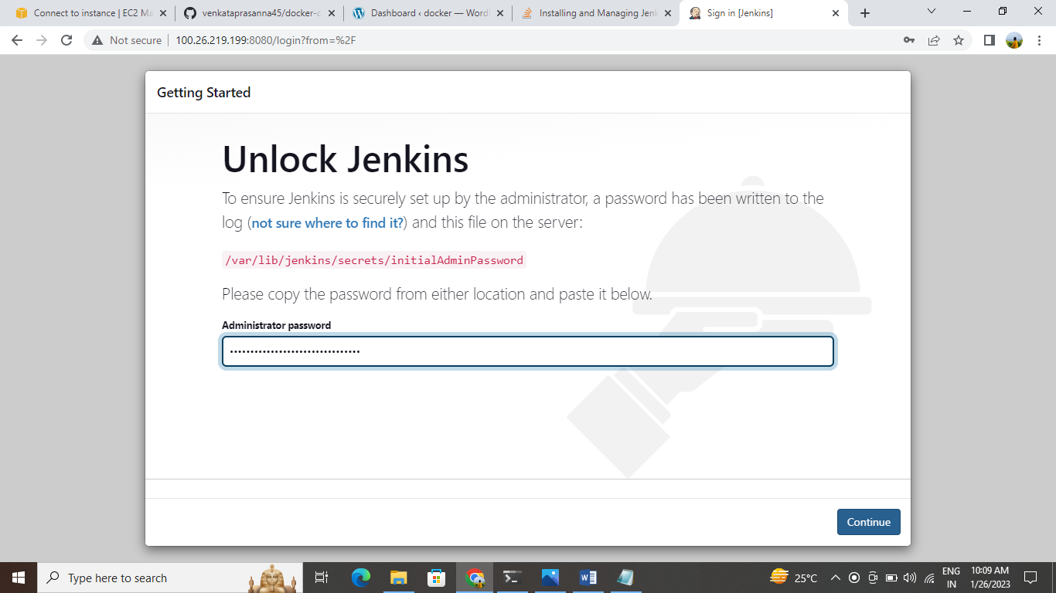
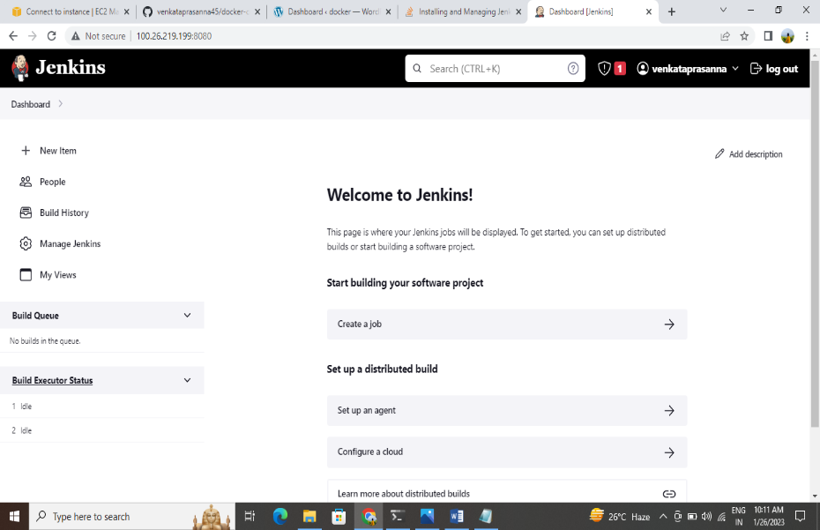
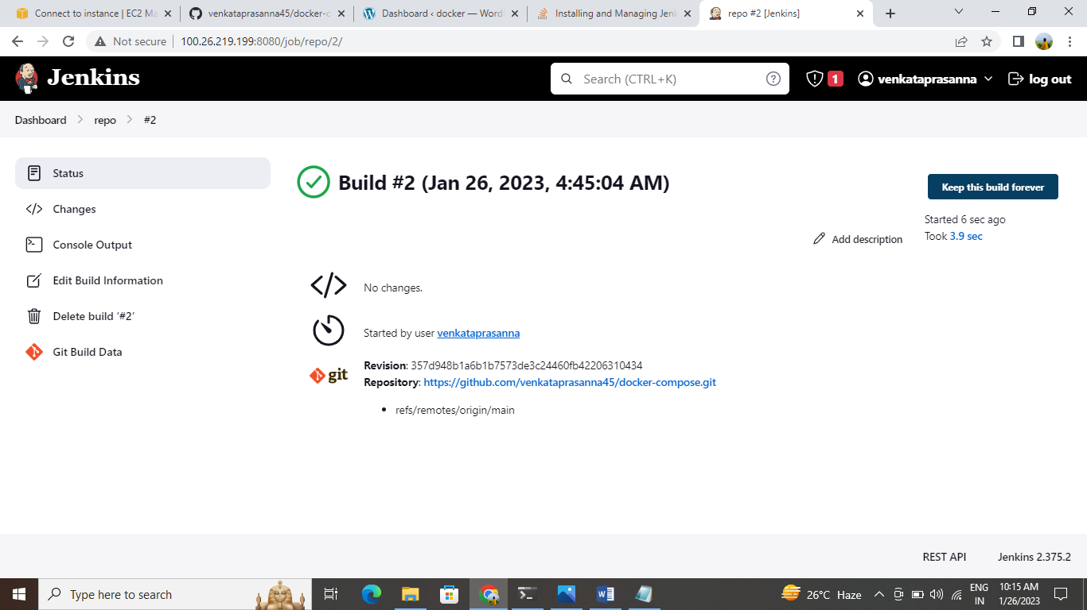
Jenkins web application

Slide 11


